Slide 1
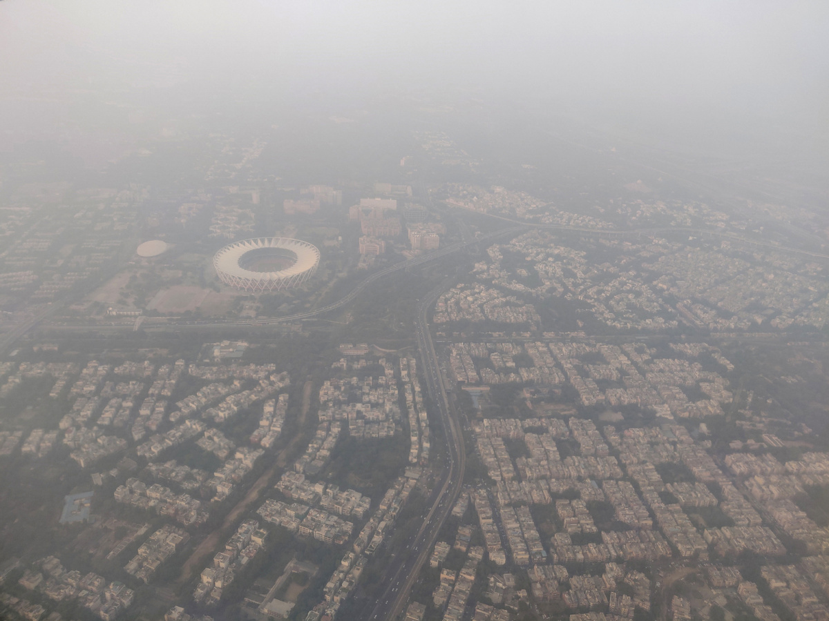
AQI India
May 2026
AI-POWERED AIR
QUALITY MONITORING
Real-Time AQI Intelligence for 20+ Indian Cities
Powered by Machine Learning Forecasting
Good___Satisfactory__Moderate___Poor_____Severe

Slide 2
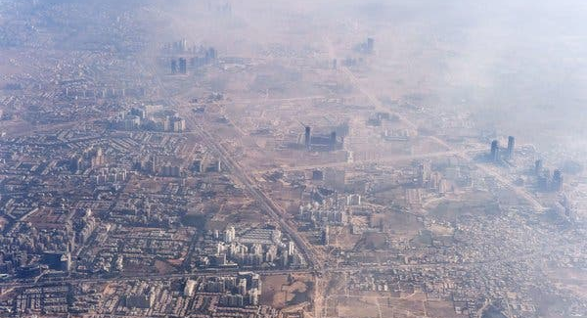
AQI India
CONTENTS
01 The Air Quality Crisis | 02 AI Forecasting Engine
03 Health Intelligence | 04 Platform Features
Current AQI landscape across India | 7-day predictive analytics
Personalized advisory system | Interactive maps & data sources

Slide 3
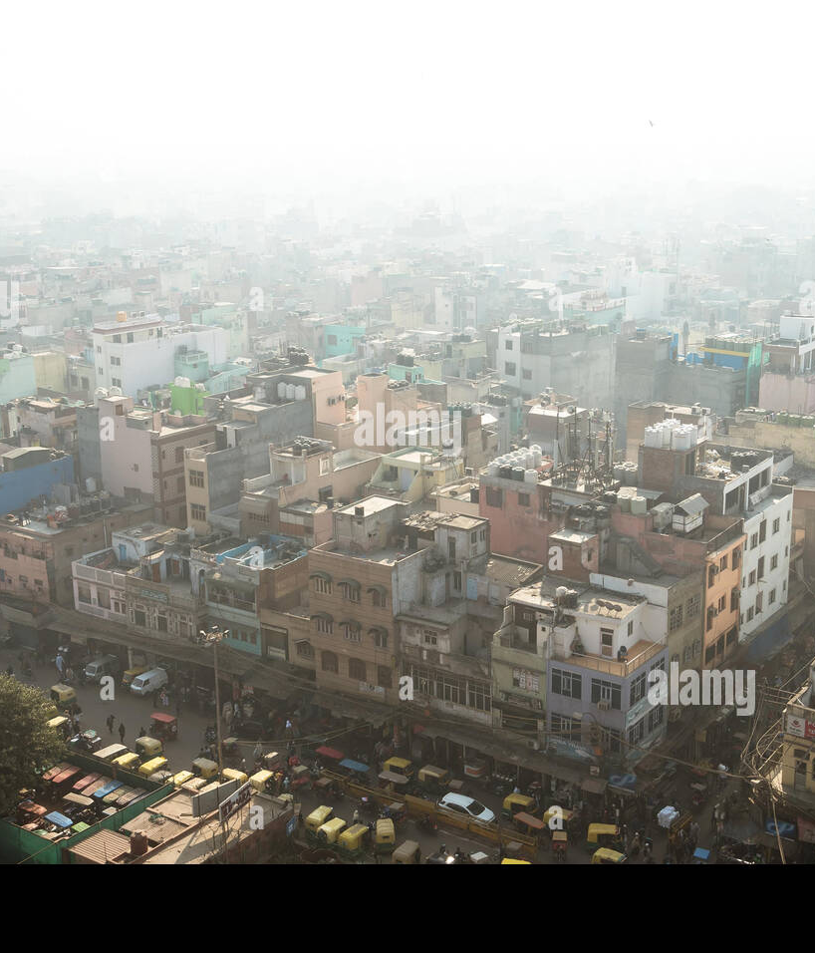
AQI India
01
THE AIR QUALITY
CRISIS
Understanding pollution levels across 20+ Indian cities
with real-time monitoring from CPCB stations

Slide 4
AQI India
Current AQI Across Major Cities
312
298
287
276
245
198
Lucknow
Kanpur
Delhi
Patna
Jaipur
Kolkata
SEVERE
SEVERE
POOR
POOR
POOR
MODERATE
📈 Rising
📈 Rising
📈 Rising
📉 Falling
📈 Rising
📉 Falling
7d avg: 298
7d avg: 285
7d avg: 265
7d avg: 290
7d avg: 238
7d avg: 210
165
142
134
112
96
78
Ahmedabad
Mumbai
Hyderabad
Pune
Bangalore
Chennai
POOR
MODERATE
MODERATE
MODERATE
SATISFACTORY
SATISFACTORY
📈 Rising
📉 Falling
📈 Rising
📉 Falling
📉 Falling
📈 Rising
7d avg: 158
7d avg: 155
7d avg: 128
7d avg: 125
7d avg: 102
7d avg: 82
Data: CPCB Real-Time Monitoring Stations | Updated: May 2026
04

Slide 5
AQI India
AQI Categories & Health Impact
0-50
51-100
101-200
201-300
300+
GOOD
SATISFACTORY
MODERATE
POOR
SEVERE
Minimal impact on health. Air quality is satisfactory and poses little or no risk.
Minor breathing discomfort for sensitive people. Acceptable air quality for most.
Breathing discomfort for people with lung disease. Sensitive groups should limit exposure.
Breathing discomfort for most people. Health effects may be experienced by everyone.
Serious health effects for everyone. Emergency conditions. Avoid all outdoor exposure.
No restrictions
Enjoy outdoor activities
Normal activities
Minor precautions for sensitive individuals
Reduce prolonged exertion
Sensitive groups limit outdoor time
Limit outdoor activities
Wear mask, keep windows closed
Stay indoors
Use air purifiers, N95 mandatory
05

Slide 6
AQI India
Real-Time Pollutant Monitoring
Current levels vs. safe limits — Delhi NCR (CPCB Station Data)
Pollutant | Current | Safe Limit | Compliance | Status | Primary Source
PM2.5 | 142 μg/m³ | 60 | 237% | ● Critical | Vehicles, Industry, Burning
PM10 | 198 μg/m³ | 100 | 198% | ● Unsafe | Dust, Construction
NO₂ | 78 μg/m³ | 80 | 98% | ● Near Limit | Traffic, Power Plants
O₃ | 45 μg/m³ | 100 | 45% | ● Safe | Sunlight + NOx
CO | 1.2 mg/m³ | 2.0 | 60% | ● Safe | Vehicle Exhaust
Source: CPCB Real-Time Monitoring | Updated: May 2026
06

Slide 7
AQI India
02
AI FORECASTING
ENGINE
Machine Learning predictions powered by
Random Forest regression for 7-day forecasting

Slide 8
AQI India
7-Day AI Forecast — Delhi
Day | AQI | Level | Trend
1 | 287 | Poor | 📈
2 | 298 | Poor | 📈
3 | 312 | Severe | 📈
4 | 305 | Severe | 📉
5 | 289 | Poor | 📉
6 | 265 | Poor | 📉
7 | 242 | Poor | 📉
87% Prediction Accuracy within ±15 AQI points
Random Forest trained on 3 years of CPCB historical data
Pattern Recognition for seasonal trends
Festival impacts, weather correlations, diurnal cycles
ML Model: Random Forest Regression | Data: CPCB Historical
08

Slide 9
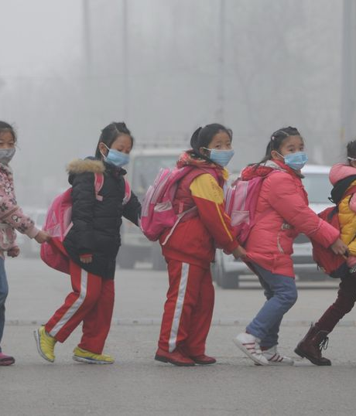
AQI India
03
HEALTH
INTELLIGENCE
Personalized health recommendations based on
real-time AQI, age group, and medical conditions

Slide 10
AQI India
Dynamic Health Advisory System
Actionable health advice updates dynamically based on current AQI readings
0-50 GOOD
51-100 SATISFACTORY
101-200 MODERATE
201-300 POOR
300+ SEVERE
No restrictions
Enjoy outdoor activities freely. Air quality is satisfactory with minimal health risk.
Normal activities
Minor precautions for sensitive individuals. Monitor symptoms if you have respiratory conditions.
Reduce exertion
Sensitive groups should limit outdoor exposure. Consider shorter outdoor sessions.
Limit outdoor
Wear mask outside. Keep windows closed. Use air purifiers indoors if available.
Stay indoors
Use air purifiers. N95 mask mandatory if going outside. Seek medical help if symptoms appear.
✓ Outdoor exercise
✓ Windows open
✓ No mask needed
✓ Most activities
△ Sensitive groups cautious
✓ No mask needed
△ Limit prolonged outdoor
△ Sensitive groups stay in
△ Mask optional
✗ Avoid outdoor exercise
✗ Keep windows closed
● Wear N95 mask
✗ Stay indoors
● N95 mask mandatory
● Air purifier essential
10

Slide 11
AQI India
Personalized Protection by Age & Health
AGE-SPECIFIC RECOMMENDATIONS
Children
Seniors (60+)
Pregnant Women
Adults
• Keep indoors when AQI > 150
• Limit outdoor play during high pollution
• Use N95 masks designed for kids
• Ensure schools have air purifiers
• Avoid morning walks during high pollution
• Stay hydrated throughout the day
• Keep medications accessible
• Monitor for breathing difficulty
• Minimize outdoor exposure
• Use indoor air purification
• Avoid peak traffic hours
• Consult doctor if feeling unwell
• Follow standard AQI precautions
• Wear N95 when AQI > 200
• Limit outdoor exercise in poor air
• Use air purifiers at home/office
HEALTH CONDITION CONSIDERATIONS
Asthma
Allergies
Heart Disease
• Keep inhaler accessible at all times
• Monitor symptoms closely when AQI > 100
• Pre-medicate before going outside
• Avoid peak pollution hours (morning/evening)
• Keep windows closed during high pollen + pollution
• Use antihistamines as prescribed
• Minimize outdoor exertion when AQI > 150
• Seek medical advice if symptoms appear
• Avoid morning walks in poor air quality
11

Slide 12
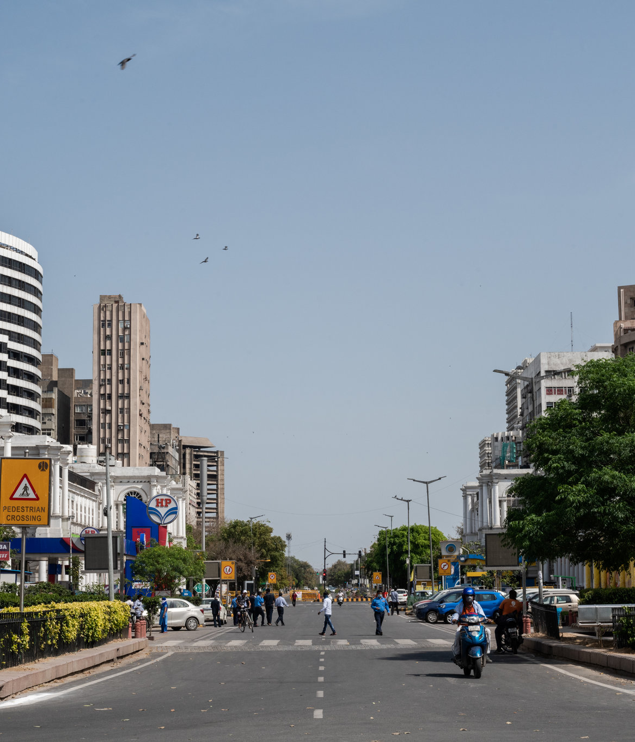
AQI India
04
PLATFORM
FEATURES
Interactive visualization, city selection,
and comprehensive data integration

Slide 13
AQI India
Interactive India Map & Quick City Select
AQI Scatter Map — India
Quick City Select
Delhi 287
Mumbai 142
Bangalore 96
Chennai 78
Kolkata 198
Hyderabad 134
Pune 112
Ahmedabad 165
Delhi — Detailed View
287
265
342
156
Current AQI
7-Day Avg
Peak (30d)
Best (30d)
Interactive map with color-coded AQI markers across India
13

Slide 14
AQI India
Data Sources & Platform Architecture
PRIMARY DATA SOURCES
KEY METRICS DISPLAYED
CPCB Monitoring Stations
Central Pollution Control Board real-time station data across India
Current AQI with color-coded category badge
7-Day Average with trend direction indicator
Real-Time City Coverage
Delhi, Mumbai, Bangalore, Chennai, Kolkata, Hyderabad + 15 more
Peak AQI from the last 30 days
Historical Pattern Database
3+ years of historical data for AI model training and trend analysis
Best AQI from the last 30 days
Daily Forecast for the next 5-7 days
Weather API Integration
Meteorological data for pollution-weather correlation modeling
Pollutant Breakdown with safe limit percentage bars
Continuous Data Refresh
Hourly updates from all active monitoring stations nationwide
Tech: Random Forest ML | Real-Time APIs | Responsive React Frontend
All data sourced from official CPCB monitoring stations
14

Slide 15
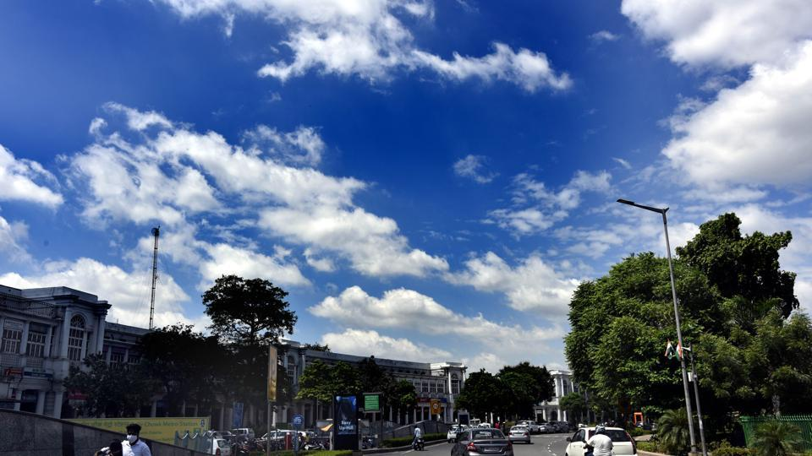
BREATHE SMARTER
Monitor. Forecast. Protect.
Your AI-powered air quality companion for healthier living across India
Get Started Today
AQI India

